Slide 1


SAP UI5 & FIORI with OData TRAINING
Anubhav Oberoy & Nishan Nainsukha
Day – 5

Slide 2

Agenda
Introduction to Nodejs
Understanding the uses of Nodejs
Introduction to Client-Server Architecture
---SAP UI5--
Introduction to UI5
Responsive web design
Structure of UI5 Framework
Introduction to UI5 SDK

Slide 3
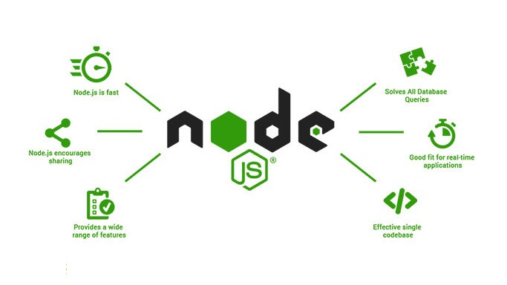
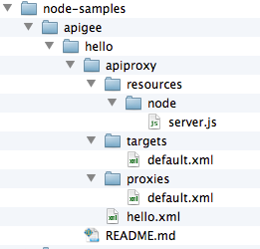
Introduction NodeJS
Node JS is an open-source, cross platform, java script runtime environment and used to execute Java Script on Server Side.
Node JS is also a great web framework for beginners because it works great for data intensive applications like streaming, gaming and real time apps. It leverage the power of JS’s Asynchronous non blocking IO.
As an asynchronous event-driven JavaScript runtime, Node.js is designed to build scalable network applications.
Node.js is an open source, cross-platform runtime environment for developing server-side and networking applications. Node.js applications are written in JavaScript, and can be run within the Node.js runtime on OS X, Microsoft Windows, and Linux.
NodeJS Project Structure

Slide 4
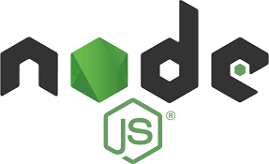

Features of NodeJS
Asynchronous and Event Driven − All APIs of Node.js library are asynchronous, that is, non-blocking. It essentially means a Node.js based server never waits for an API to return data. The server moves to the next API after calling it and a notification mechanism of Events of Node.js helps the server to get a response from the previous API call.
Very Fast − Being built on Google Chrome's V8 JavaScript Engine, Node.js library is very fast in code execution.
Single Threaded but Highly Scalable − Node.js uses a single threaded model with event looping. Event mechanism helps the server to respond in a non-blocking way and makes the server highly scalable as opposed to traditional servers which create limited threads to handle requests. Node.js uses a single threaded program and the same program can provide service to a much larger number of requests than traditional servers like Apache HTTP Server.
No Buffering − Node.js applications never buffer any data. These applications simply output the data in chunks.
License − Node.js is released under the MIT license

Slide 5
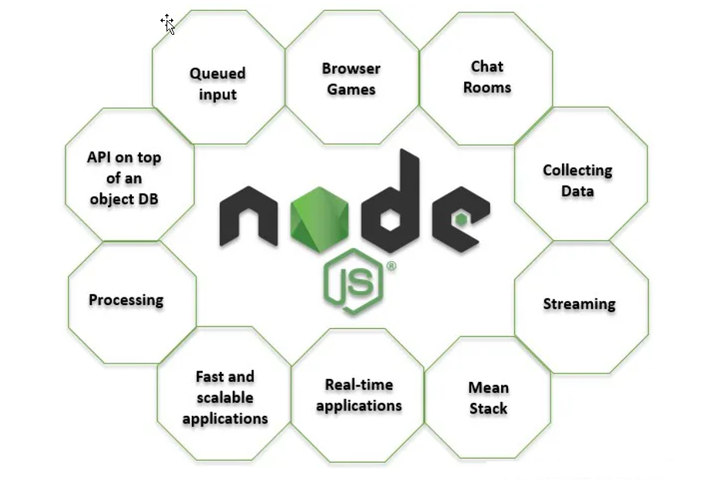
Uses of NodeJS
Build Backend Application Logic
Web Server (express)
Send Emails
DB lookup
Uses
Automation
Host a Web Server
Output to the user
Use its eco-system like PDF, EXCEL, EMAIL

Slide 6
Client Server Architecture
The Client-server model is a distributed application structure that partitions task or workload between the providers of a resource or service, called servers, and service requesters called clients.
In the client-server architecture, when the client computer sends a request for data to the server through the internet, the server accepts the requested process and deliver the data packets requested back to the client. Clients do not share any of their resources. Examples of Client-Server Model are Email, World Wide Web, etc.
Client: When we talk the word Client, it mean to talk of a person or an organization using a particular service. Similarly in the digital world a Client is a computer (Host) i.e. capable of receiving information or using a particular service from the service providers (Servers).
Servers: Similarly, when we talk the word Servers, It mean a person or medium that serves something. Similarly in this digital world a Server is a remote computer which provides information (data) or access to particular services.
Client
Browser
Server
Node JS
Client-Side Java Script

Slide 7

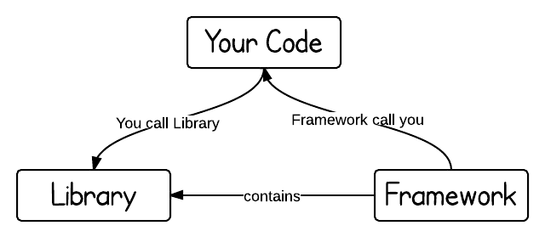
Introduction to UI5
SAPUI5 (SAP user interface for HTML5) or Open UI5 is a collection of libraries that you can use to build desktop and mobile applications that run in a browser. With the SAPUI5 JavaScript toolkit, you can create web applications using HTML5 web development standards.
SAP UI5 is a framework which is used to develop Responsive web applications to run on any platform, any browser and any OS.
Framework: - A framework, or software framework, is a platform for developing software applications. It provides a foundation on which software developers can build programs for a specific platform.
A framework may include predefined classes and functions that can be used to process input, manage hardware devices, and interact with system software.
Library: - A collection of Classes.
Classes: - Collection of methods, Attributes, Events.

Slide 8

Responsive Web Design
Responsive web design (RWD) is a web development approach that creates dynamic changes to the appearance of a web application, depending on the screen size and orientation of the device being used to view it.
Responsive Web Design is about using HTML and CSS to automatically resize, hide, shrink, or enlarge, a website, to make it look good on all devices (desktops, tablets, and phones).
Now a days, all the frameworks are designed to adept the UI according to the screen size of the device.

Slide 9
Structure of UI5 Framework
The UI5 framework is built on top of open standards like HTML5, CSS, JS, and jQuery. We use MVC architecture to create applications using SAPUI5.
BAS or
VSCode
App
SAP UI5 Design Time Component
SAPUI5 Runtime Component
HTML+CSS+JS
sap.m
sap.ui.comp
sap.ui.table
sap.ui.layout
Renderer
sap.ui.core
sap.ui.unified
sap.ui.core.mvc
HTML5
CSS
JS
jQuery

Slide 10
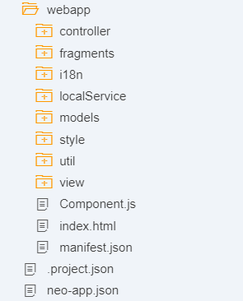
Project Structure of UI5 Project
When you create a new SAPUI5 application, you will be able to see a folder structure created in your project explorer like below.
In a SAP project there are a number of folders and files that you will not recognize if you are not familiar with MVC. Let's have a quick overview.
Within a given project, you have three core folders.
Model
View
Controller

Slide 11
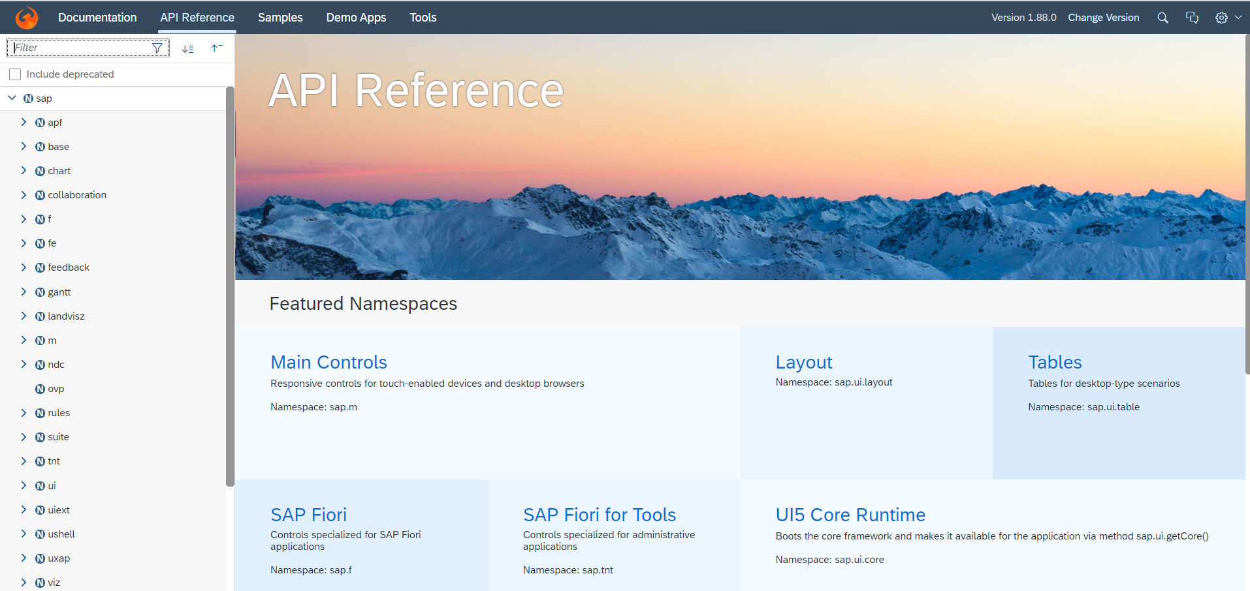
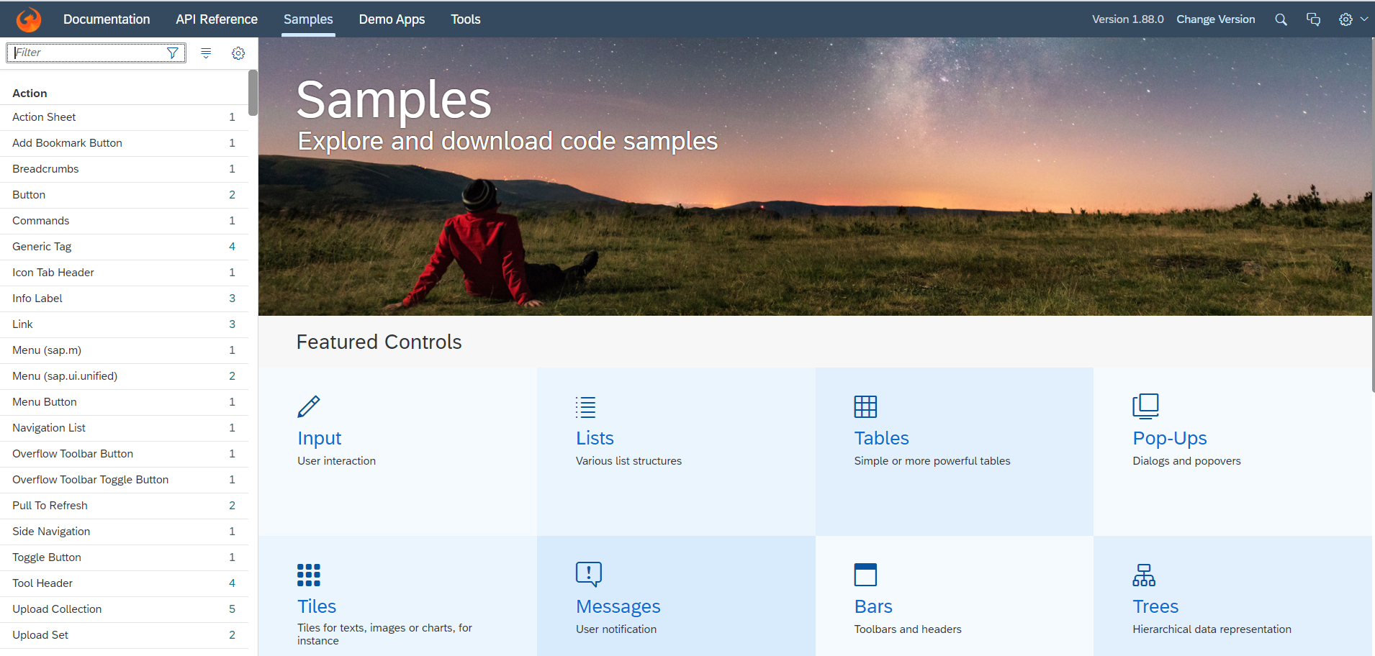
Introduction to UI5 SDK
Documentation of SAP UI5 is available at the SAPUI5 Software Development Kit.
We can access the SAP UI5 API’s at the Documentation page of SAP UI5 or you can use the link to go to sap’s API screen - https://sapui5.hana.ondemand.com/#/api
We can directly search the required api’s on the SDK.
SDK contains the sample of all the controls which we can use in UI5
SAP UI5 API reference screen
SAP UI5 Sample reference screen

Slide 12
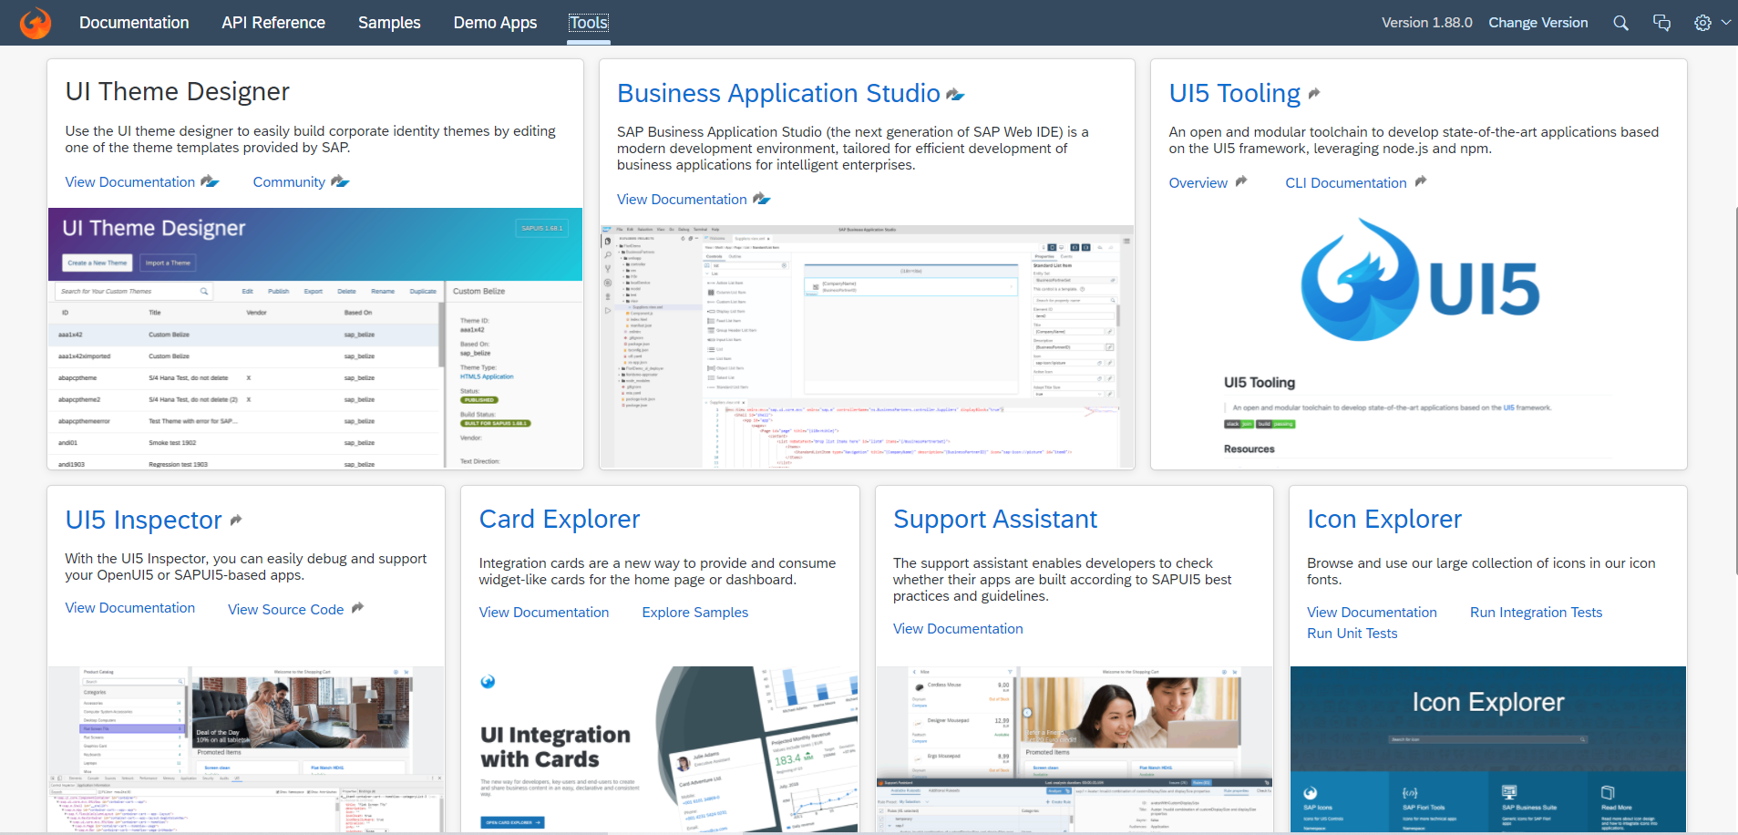
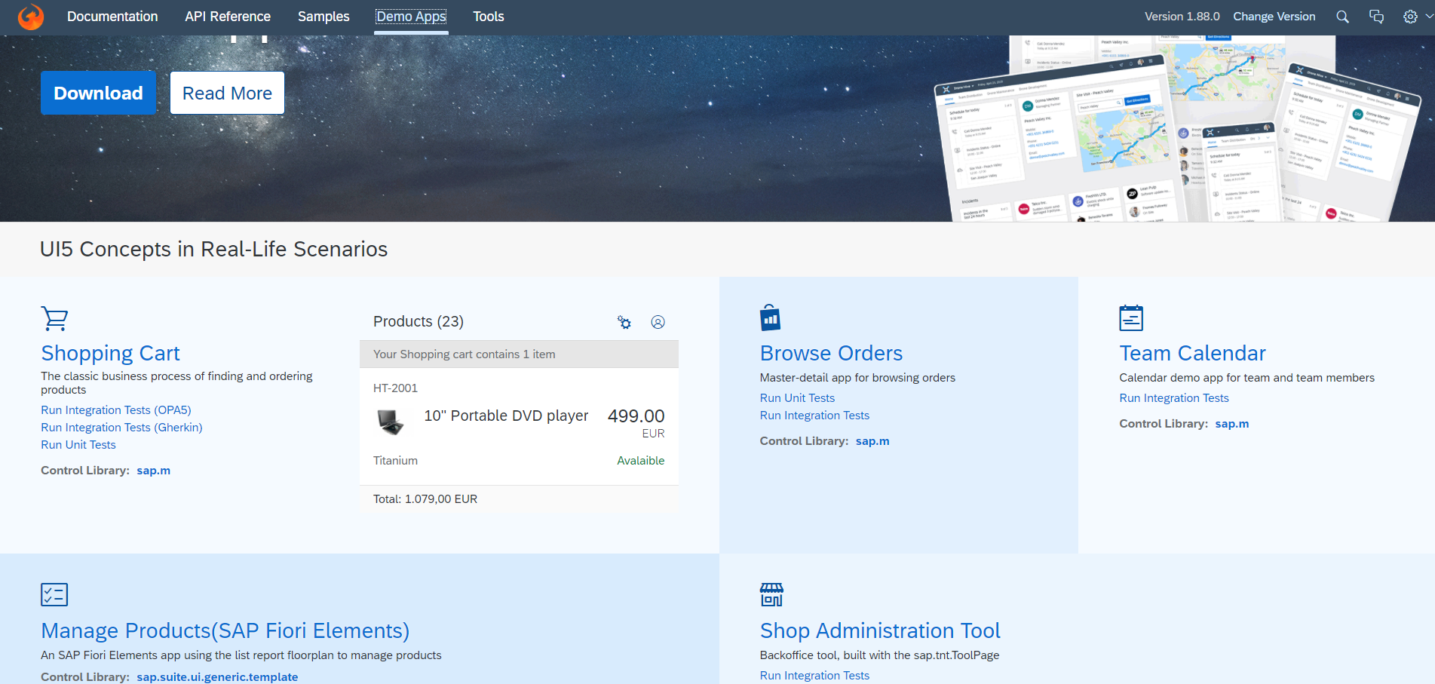
UI5 SDK continues…
UI5 SDK contains tools to make the development smooth for the developers.
It has UI5 icon packs which can be directly accessed for the UI5 SDK’s Tool Screen (Link).
SAP UI5 SDK provides us the demo application, So we can get an idea about how to create different type of applications using UI5 controls
UI5 SDK Tools Screen
UI5 SDK Demo Apps Screen

Slide 13
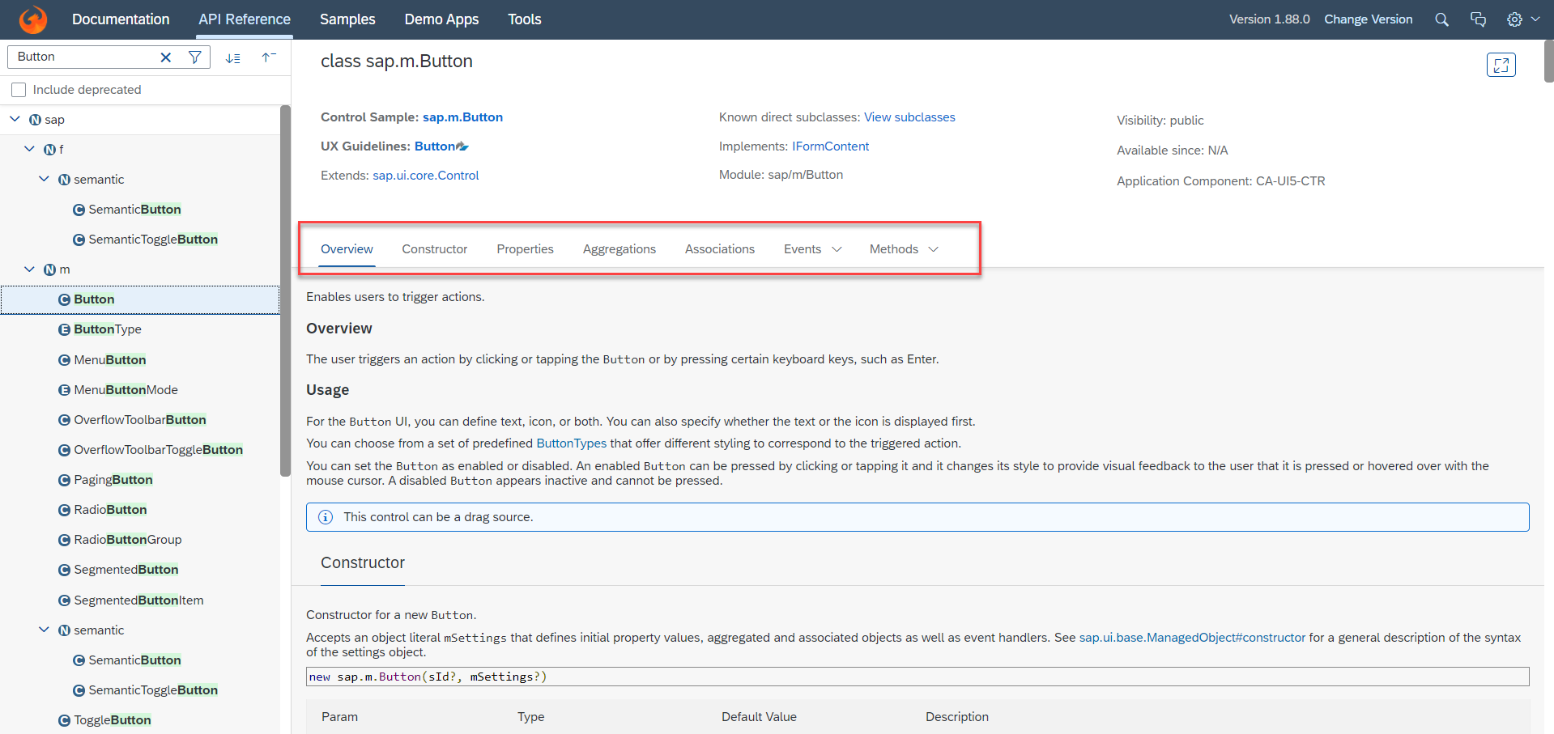
UI5 SDK continues…
When we search and open any API we see a screen similar to one which is shown below.
Every API contains different kind of:
Properties,
Aggregations,
Associations,
Events,
Methods

Slide 14

End of Day 5

Slide 15

Any Questions ?

Slide 16

Anubhav Oberoy

Slide 17
Title
Content

Slide 18
Title
Content

